Slide 1

现代通信光电子学
第14章：受激布里渊散射
电子科技大学信息与通信工程学院
2018-2019秋季学期

Slide 2
Stimulated Brillouin Scattering
Basic Concepts
Quasi-CW SBS
Brillouin Fiber Ampliﬁers
SBS Dynamics
Sensing Applications

Slide 3
Basic Concepts
The Stokes wave propagates backward when SBS occurs in a
single-mode optical ﬁber, in contrast to SRS that can occur in both directions.
The Stokes shift (∼10 GHz) is smaller by three orders of magnitude for SBS compared with that of SRS. The threshold pump power for SBS depends on the spectral width associated with the pump wave. It can be as low as 1 mW for a CW pump, or when the pumping is in the form of relatively wide pulses (width >1 μs). In contrast, SBS nearly
ceases to occur for short pump pulses (width <1 ns).
All of these differences stem from a single fundamental change—acoustical phonons participate in SBS whereas optical phonons are involved in the case of SRS.

Slide 4



Basic Concepts
SBS can be described classically as a nonlinear interaction between the pump and Stokes ﬁelds through an acoustic wave. The pump ﬁeld generates an acoustic wave through the process of electrostriction. The acoustic wave in turn modulates the refractive index of the medium. This pump-induced index grating scatters the pump light through Bragg diffraction. Scattered light is downshifted in frequency because of the Doppler shift associated with a grating moving at the acoustic velocity v_{A}.
As both the energy and the momentum must be conserved during each scattering event, the frequencies and the wave vectors of the three waves are related by
The frequency Ω_{B} and the wave vector k_{A} of the acoustic wave satisfy the standard dispersion relation
The frequency shift of the Stokes wave depends on the scattering angle. In a single-mode optical ﬁber, only relevant directions are the forward and backward directions.

Slide 5








Brillouin-Gain Spectrum
SBS occurs only in the backward direction with the Brillouin shift given by
The spectral width of the SBS gain spectrum is very small (∼10 MHz in lieu of ∼10 THz) because it is related to the damping time of acoustic waves related to the phonon lifetime. When acoustic waves decay as
exp(−Γ_{B}t), the Brillouin gain has a Lorentzian spectrum of the form
where the peak value of the Brillouin gain at Ω = Ω_{B} is given by
Electrostrictive constant of silica
Density
Phonon lifetime

Slide 6
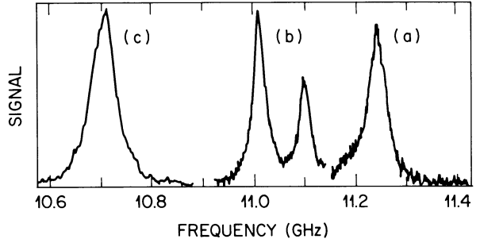

Brillouin-Gain Spectrum
ν_{B} varies inversely with λ_{p}, Δν_{B} follows a λ_{p}⁻² dependence on the pump wavelength. This narrowing of the Brillouin-gain proﬁle with an increase in λ_{p} cancels the decrease in gain. As a result, the peak value g_{p} is nearly independent of the pump wavelength.
The Brillouin-gain spectrum for silica ﬁbers can differ signiﬁcantly from that of bulk silica because of the guided nature of optical modes and the presence of dopants in the ﬁber core.
Nearly inverse dependence on GeO2 concentration; The double-peak structure results from an inhomogeneous distribution of GeO₂.

Slide 7
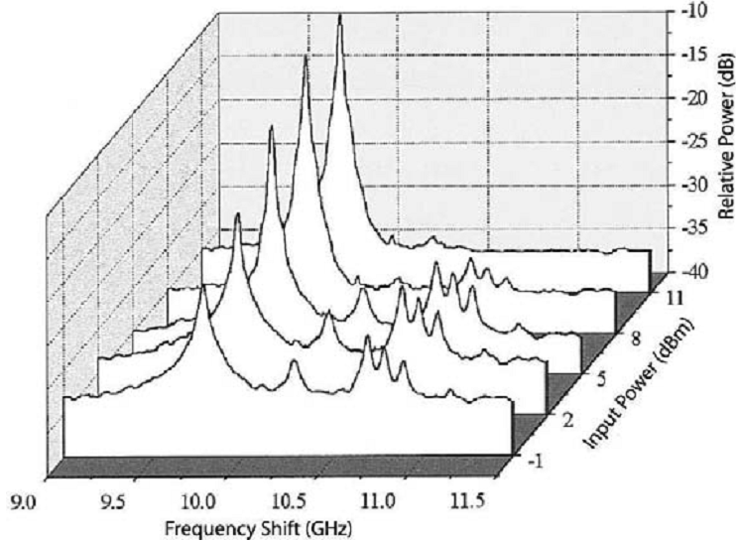
Brillouin-Gain Spectrum
More recent measurements indicate that the Brillouin-gain spectrum depends considerably on details of the ﬁber design and may contain multiple peaks that have their origin in different acoustic modes supported by the ﬁber.
The dominant peak occurs at 9.77 GHz but 4 smaller peaks are clearly seen.

Slide 8
Brillouin-Gain Spectrum
The Brillouin-gain bandwidth Δν_{B} and is related to the phonon lifetime. In fibers the bandwidth is much larger than that expected for bulk silica. A part of the increase is due to the guided nature of acoustic modes in optical ﬁbers; most of the increase can be attributed to inhomogeneities in the ﬁber-core cross section along the ﬁber length; the numerical aperture of the ﬁber also plays a role in broadening the gain spectrum.
For pump pulses of width T₀ < T_{B}, the Brillouin gain is substantially reduced, if the pulse width becomes much smaller than the phonon lifetime (T₀ < 1 ns), the Brillouin gain is reduced below the Raman gain.
Even for a CW pump, the Brillouin gain is reduced considerably if the spectral width Δν_{p} of the pump exceeds Δν_{B}. This can happen when a multimode laser is used for pumping. It can also happen for a single-mode pump laser whose phase varies rapidly on a time scale shorter than the phonon lifetime T_{B}.
The Brillouin gain is reduced signiﬁcantly if L_{coh} <<L_{int}, In the case of a pump laser with a Lorentzian spectral proﬁle of width Δν_{P}, the peak value of Brillouin gain is reduced by a factor 1+ Δν_{P} / Δν_{B}.

Slide 9
Stimulated Raman Scattering
Basic Concepts
Quasi-CW SBS
Brillouin Fiber Ampliﬁers
SBS Dynamics
Sensing Applications

Slide 10



Brillouin Threshold
Under steady-state conditions, applicable for a CW or quasi-CW pump, SBS is governed by the two coupled equations similar to the SRS case. The only difference is that the sign of dI_{s}/dz should be changed to account for the counterpropagating nature of the Stokes wave with respect to the pump wave.
The coupled equations assume implicitly that the counterpropagating pump and Stokes waves are linearly polarized along the same direction and maintain their states of polarization along the ﬁber. This is the case when the two waves are polarized along a principal axis of a polarization-maintaining ﬁber.

Slide 11






Brillouin Threshold
To estimate the Brillouin threshold, pump depletion can be neglected. Using I_{p}(z)= I_{p}(0)e−^{αz} and integrating it over the ﬁber length L, the Stokes intensity is found to grow exponentially in the backward direction
Where
A Stokes signal incident at z=L grows in the backward direction because of Brillouin ampliﬁcation occurring as a result of SBS. The Brillouin threshold is found to occur at a critical pump power P_{cr} such that
In contrast with the case of the Raman gain, the Brillouin gain vanishes when the pump and Stokes are linearly as well as orthogonally polarized.

Slide 12
Controlling the SBS Threshold
The acoustic velocity in germania doped ﬁbers is reduced near the center
of the core as v_{A} = 5.944(1−b_{x}x) km/s, where b_{x} =0.0072 and x represents the fraction of germania concentration. Because of such radial effects, it is possible to design a refractive index proﬁle such that the SBS threshold is doubled.
Variations in ﬁber parameters along the ﬁber length are even more helpful in controlling the SBS threshold. For example, if the Brillouin shift ν_{B} along the ﬁber length is made inhomogeneous such that it shifts by more than the SBS gain bandwidth, the Stokes will cease to grow after the shift because of a substantial reduction in the Brillouin gain.
ν_{B} depends on both the acoustic velocity v_{A} and the mode index n_{p} at the pump wavelength, and it can be shifted if one of these parameters changes along the ﬁber length. The mode index n_{p} depends not only on ﬁber parameters such as the core diameter and doping levels but also on environmental factors such as temperature and stress.

Slide 13
Controlling the SBS Threshold
A common technique for SBS suppression consists of modulating the phase of the pump beam before it is launched into the ﬁber. It turns out that a phase modulation is equivalent to changing Ω_{B} along the ﬁber length.
In practice, the pump phase is modulated sinusoidally using an
electro-optic phase modulator. Typically, modulation frequency Δν_{m} is chosen in the range of 200 to 400 MHz.
Fiber gratings can also be used to increase the SBS threshold. The Bragg grating is designed such that it is transparent to the forward-propagating pump beam, but the spectrum of the Stokes wave generated through SBS falls entirely within its stop band. A new Stokes wave can still build up in the ﬁber section up to the grating but its power is reduced considerably as it has to grow from noise and is ampliﬁed over a shorter distance.
For the multi-mode case, the input pump power is distributed among many ﬁber modes, and each pump mode can also contribute to multiple Stokes modes.

Slide 14
Stimulated Raman Scattering
Basic Concepts
Quasi-CW SBS
Brillouin Fiber Ampliﬁers
SBS Dynamics
Sensing Applications

Slide 15









Gain Saturation
When the pump and signal waves counterpropagate inside an optical ﬁber, a large part of the pump power can be transferred to the Stokes wave when their frequencies differ by the Brillouin shift. Initially, the signal power increases exponentially. However, this growth is reduced when the Brillouin gain begins to saturate.
Where
The parameter b₀ is a measure of the SBS efﬁciency as it shows what fraction of the input pump power is converted to the Stokes power. The quantity g₀ is the small-signal gain associated with the SBS process. we deﬁne the saturated gain using
The unsaturated gain

Slide 16
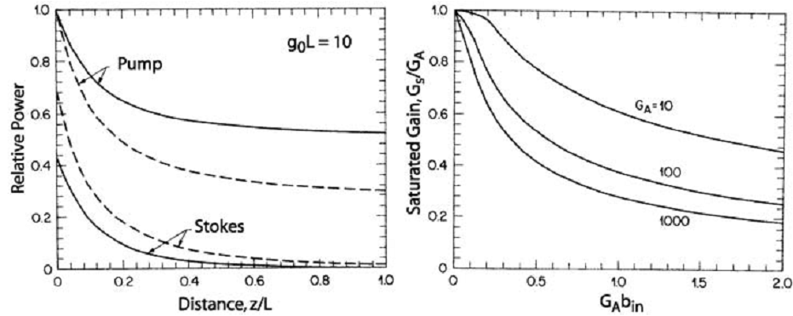

Gain Saturation
The value of g₀L = 10 corresponds to unsaturated ampliﬁer gain of 43 dB. Because of pump depletion, the net gain is considerably smaller. Nonetheless, about 50% and 70% of the pump power is transferred to the Stokes for b_{in} = 0.001 and 0.01, respectively. Note also that most of the power transfer occurs within the ﬁrst 20% of the ﬁber length. The saturated gain is reduced by 3 dB when G_{A}b_{in} ≈ 0.5 for G_{A} in the range of 20 to 30 dB. This condition is satisﬁed when the ampliﬁed signal power becomes about 50% of the input pump power.

Slide 17


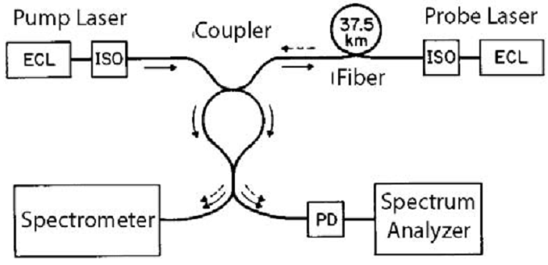

Ampliﬁer Design and Applications
Brillouin ampliﬁers may be useful in practice for applications requiring selective ampliﬁcation.
Another application of narrowband Brillouin ampliﬁers consists of using them as a tunable narrowband optical ﬁlter for channel selection in a densely packed multichannel communication system.
SBS can also be used for making distributed ﬁber sensors capable of sensing temperature and strain changes over relatively long distances.

Slide 18
Stimulated Raman Scattering
Basic Concepts
Quasi-CW SBS
Brillouin Fiber Ampliﬁers
SBS Dynamics
Sensing Applications

Slide 19






Coupled Amplitude Equations
The dynamic aspects of SBS are important because the medium response is governed by the phonon lifetime with a typical value of <10 ns in silica ﬁbers. The quasi-CW regime is thus valid only for pump pulses of widths 100 ns or more. To include the transient effects, we obtain the following set of coupled amplitude equations (GVD ignored)
Acoustic damping rate
Coupling coefﬁcients
Amplitude of the spatial distribution of the acoustic mode

Slide 20

SBS-Induced Index Changes
If we use the steady-state solution of Q in the second amplitude equation, the Stokes wave satisﬁes
where the last term represents the contribution of SBS. This term is complex for Ω ≠ Ω_{B}, and the imaginary part results from the SBS-induced index change by an amount Δn_{SBS}. If we write the imaginary part as (ω /c) Δn_{SBS}, this index change is given by
where δ = 2(Ω−Ω_{B})/Γ_{B} is a normalized detuning parameter and g_{p} = 4κ₁κ₂/Γ_{B} is the peak value of the Brillouin gain.
The physical origin of the SBS-induced index change lies in the requirement of causality that leads to the Kramers–Kronig (克拉默斯-克勒尼希) relation. According to this relation, changes in the gain (or loss) of a medium are always accompanied with changes in the refractive index.

Slide 21

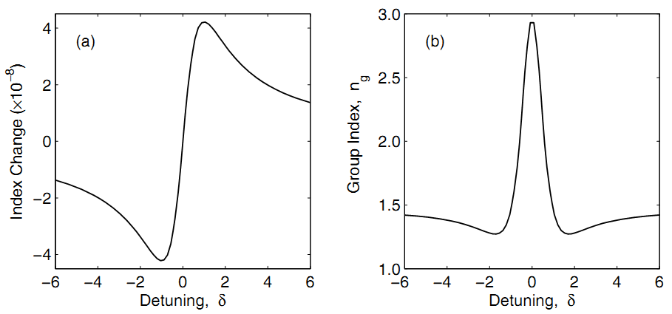

SBS-Induced Index Changes
Even though Δn_{SBS} itself is relatively small, it varies rapidly with Ω near the Brillouin-gain peak. Rapid changes in Δn_{SBS} with ω can change n_{g} considerably and affect the group velocity of a pulse. If we include the contribution of ﬁber dispersion as well, the group index is given by

Slide 22

SBS-Induced Index Changes
At this power level, index changes are ∼10⁻⁸ but the group index is doubled near the gain peak from its original value of 1.47. Thus, the Stokes pulse should propagate at only 50% of the speed expected in the absence of SBS gain. Even a larger reduction is possible by increasing the peak power of the pump. The Stokes can also be forced to propagate faster than its nominal speed by detuning it such that δ is close to 2. The transit time is obtained as
The Stokes pulse is delayed for δ < 1 but speeds up when δ ≈ 2.

Slide 23
Stimulated Raman Scattering
Basic Concepts
Quasi-CW SBS
Brillouin Fiber Ampliﬁers
SBS Dynamics
Sensing Applications

Slide 24

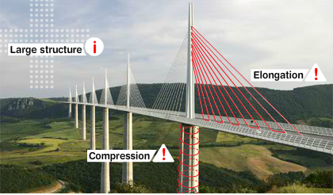

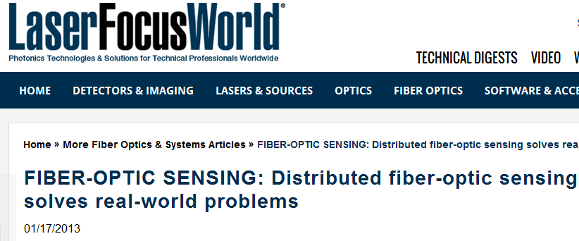
Sensing Applications

